Slide 1

Blockchain
Prof. Sunitha R
Department of Computer Science and Engineering

Slide 2

Blockchain
Consensus Algorithm: Proof of Stake (PoS)
Prof. Sunitha R
Department of Computer Science and Engineering

Slide 3
Blockchain
Consensus Algorithm – Proof of Stake(PoS)
Competitive consensus algorithm
Alternative to PoW.
Peercoin was the ﬁrst currency to utilise the PoS

Slide 4

Blockchain
Consensus Algorithm – Proof of Stake(PoS)

Slide 5
Blockchain
Consensus Algorithm – Proof of Stake(PoS)
Stake
Must lock a certain amount of its currencies, called stake, into an escrow account in order to participate in the block creation process
stakeholder, leader, forger, minter, validators, retainer
Person can mine or validate block transactions according to how many cryptocurrency he holds.
Coin age= coin*holdingdays
High coin age has a higher probability of minting the next block

Slide 6
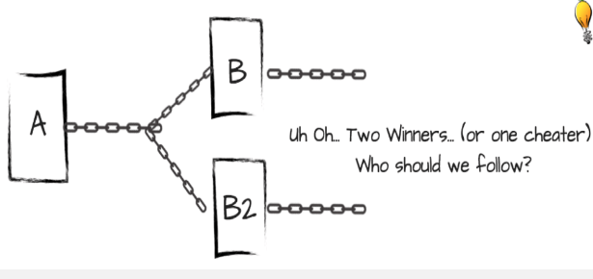
Blockchain
Consensus Algorithm – Proof of Stake(PoS)
Nothing at stake
Forking- two or more competing blocks
Stake your cryptocurrency on both blocks
PoW- not economically viable on both chains
Little cost and economic incentive

Slide 7
Blockchain
Consensus Algorithm – Proof of Stake(PoS)
Three different approaches
Chained
BFT
Delegated.

Slide 8
Blockchain
Consensus Algorithm – Proof of Stake(PoS)
Pros
It is energy efficient and does not burn electricity when mining
It can be more expensive to attack than PoW- hackers need to purchase a large percentage of the native cryptocurrency
It scales easily to handle transaction load and size

Slide 9
Blockchain
Consensus Algorithm – Proof of Stake(PoS)
Cons
Rewards are weighted to those who stake their cryptocurrency the longest. The longer a miner stakes, the greater the reward. The network structure allows wealthy stakes to control more of the network and this may centralization and censorship.
PoS is used by Ethereum, Peercoin and Nxt

Slide 10
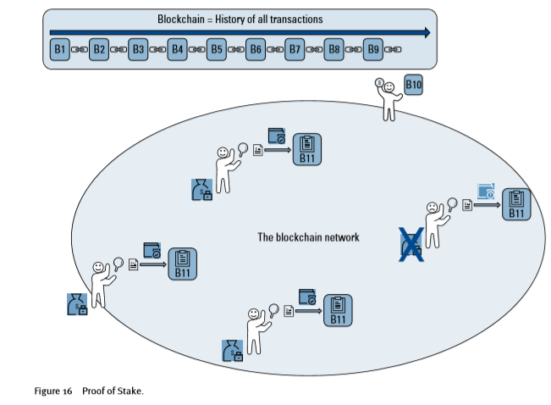
Blockchain
Consensus Algorithm – Proof of Stake(PoS)

Slide 11
Blockchain
Consensus Algorithm – Proof of Stake(PoS)
Delegated Proof of Stake(DPoS)
Reputation scores, better website and social media accounts are used to select the set of validators .
Stakeholders elect “witnesses” who will validate transactions and create blocks
EOS one of the most popular DPoS Blockchains, only has 21 witnesses.
Paid fees for producing blocks
Produce blocks one at a time in a round-robin fashion or by random selection.

Slide 12
Blockchain
Consensus Algorithm – Proof of Stake(PoS)
Delegated Proof of Stake
Pros:
Like PoS, It is energy efficient
It is fast- for example, EOS has a block time of 0.5 second.
Cons:
It is a centralized system- this may make it prone to corruption

Slide 13
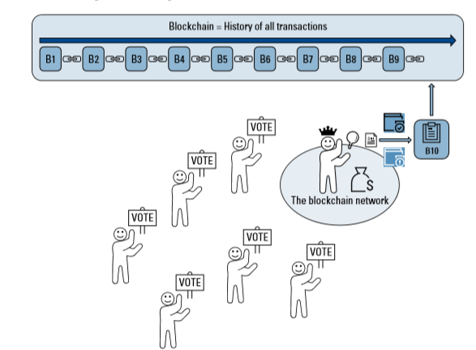
Blockchain
Consensus Algorithm – Proof of Stake(PoS)
Delegated Proof of Stake

Slide 14
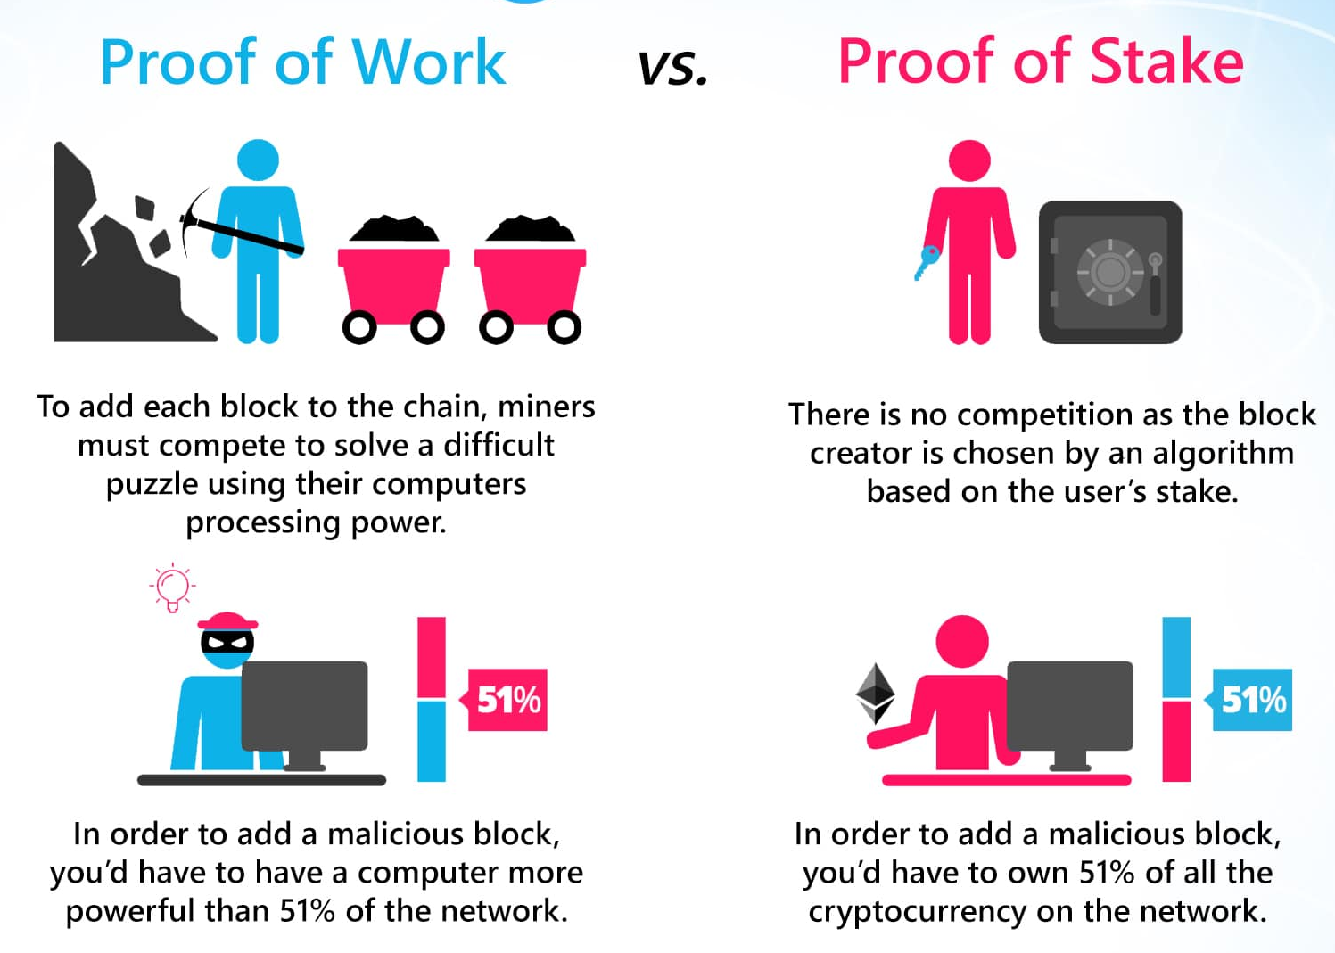
Blockchain
Consensus Algorithm- PoW Vs PoS

Slide 15
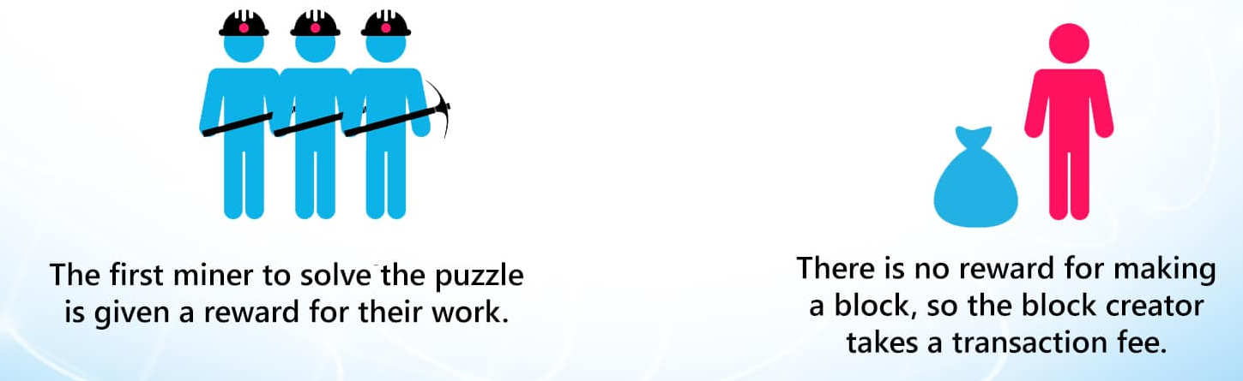
Blockchain
Consensus Algorithm- PoW Vs PoS

Slide 16
Blockchain
Supplementary readings
https://www.youtube.com/watch?v=Tm1Uoc6wtWk
https://www.youtube.com/watch?v=M3EFi_POhps

Slide 17
THANK YOU
Prof. Sunitha R
Department of Computer Science and Engineering
sunithar@pes.edu

